Slide 1


ASSAM POLICE HACKATHON
SMART MOVEMENT
TRACKER
TEAM VAJRA
SOUNDAR S

Slide 2
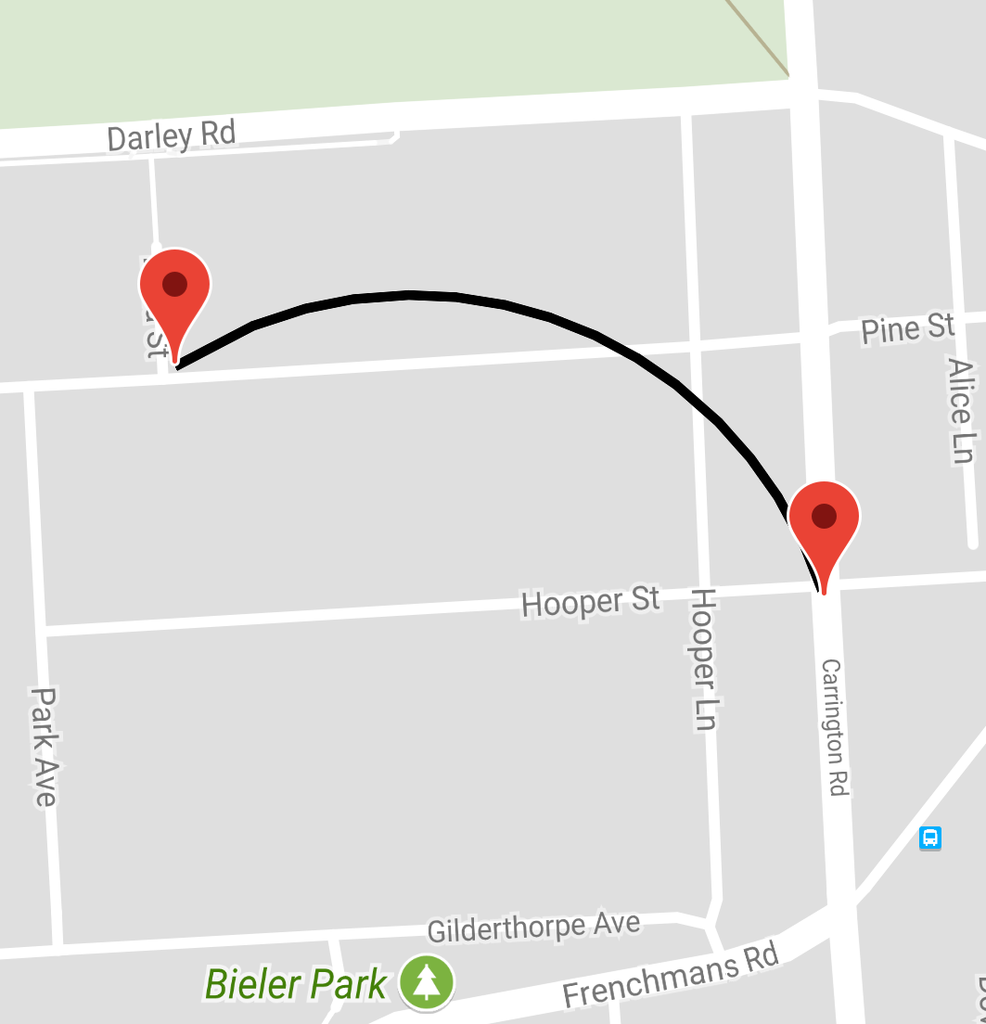
PROBLEM STATEMENT
To track the vehicle from point A to point B, in which if there is any deviation from its path, it alert or send the information about deviation along with its exact location to the corresponding law enforcement agency to track the vehicle, where actually it was.

Slide 3

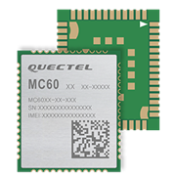
PROPOSED IDEA
To satisfy this application, we use mobile to mobile communication (M2M) system. In this system we use a powerful system on chip module - MC60 that comes under embedded system to satisfy this requirement. By using this SOC module we would get a required product efficiently.
MC60 - 2G IOT module

Slide 4
Technology used
Mobile to mobile communication
In the most basic form, a cell phone is essentially a two-way radio, consisting of a radio transmitter and a radio receiver. When you make a call with your friend on your cell phone, your phone converts your voice into an electrical signal, which is then transmitted via radio waves to the nearest cell tower.
The network of cell towers then relays the radio wave to your friend’s cell phone, which converts it to an electrical signal and then back to sound again. In the basic form, a cell phone works just like a walkie-talkie.
The Global System for Mobile Communications (GSM) is a standard developed by the European Telecommunications Standards Institute (ETSI) to describe the protocols for second-generation (2G) digital cellular networks used by mobile devices such as mobile phones and tablets. It was first deployed in Finland in December 1991.
By the mid-2010s, it became a global standard for mobile communications achieving over 90% market share, and operating in over 193 countries and territories including India.

Slide 5
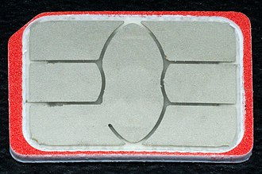
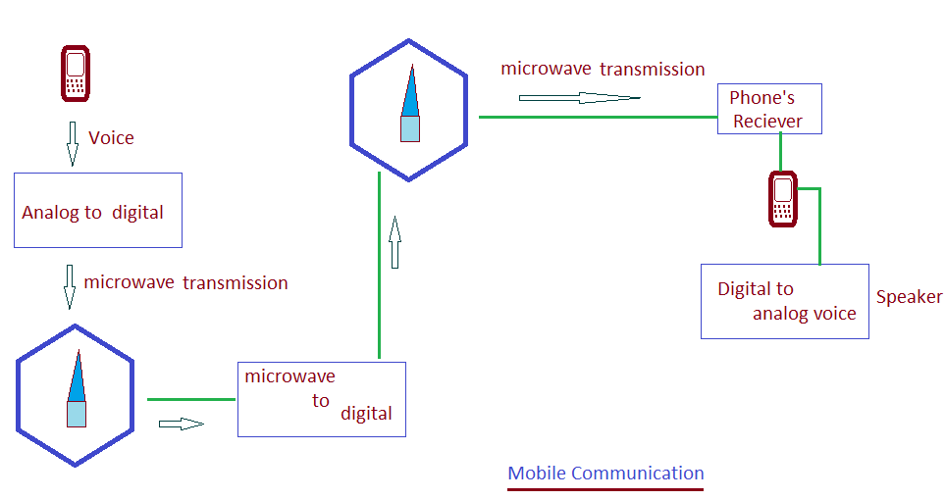
"GSM" is a trade mark owned by the GSM Association.
One of the key features of GSM is the Subscriber Identity Module, commonly known as a SIM card.
The SIM is a detachable smart card containing the user's subscription information and phone book. This allows the user to retain his or her information after switching handsets.
Simply, mobile to mobile communication is a closed system in which a particular users are connected and communicated together on a time.
We made this technology for this specific application and designed our own product which gives the efficient results.
We fix one stable device, similar to mobile phone having SMS and call function, in the vehicle which carries a specific sim card along with the module used to send and receive data or user commands.

Slide 6
Why MC60 module
The compact form factor, great positioning performance, low power consumption and dual (U)SIM card interfaces make MC60 the best choice for a wide range of M2M applications, such as automotive, telematics, wearable device, asset tracker, pet tracker, and so on.
Key Benefits
Ultra compact size: 18.7 × 16.0 × 2.1mm
Support Voice, SMS, QuecFOTA, DSSS and QuecOpen
GSM quad-band: 850/ 900/ 1800/ 1900MHz
Built-in LNA for better GNSS sensitivity
MC60 module

Slide 7
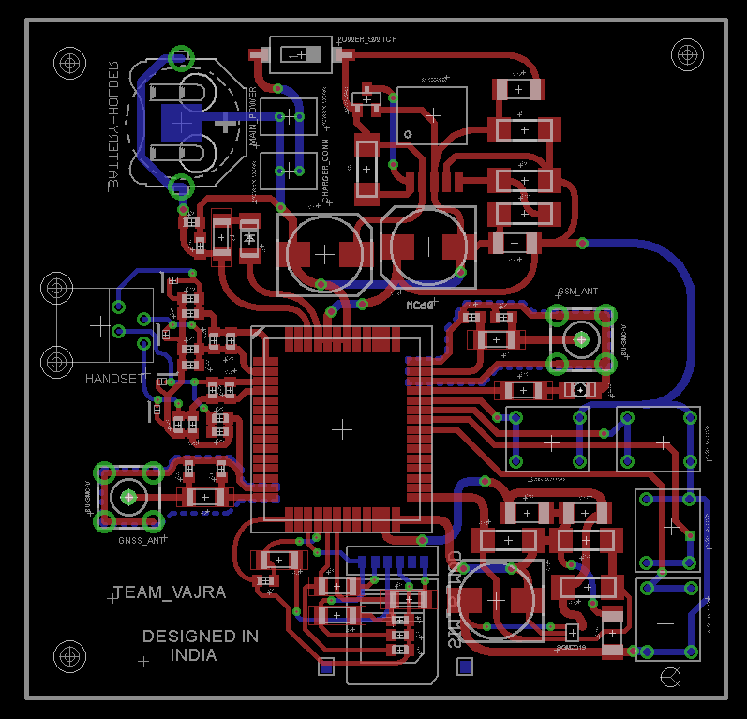

Software used for designing PCB board
We designed the PCB board using
EAGLE software,
(EAGLE – Easily Applicable Graphical
Layout Editor).
PCB BOARD DESIGN

Slide 8
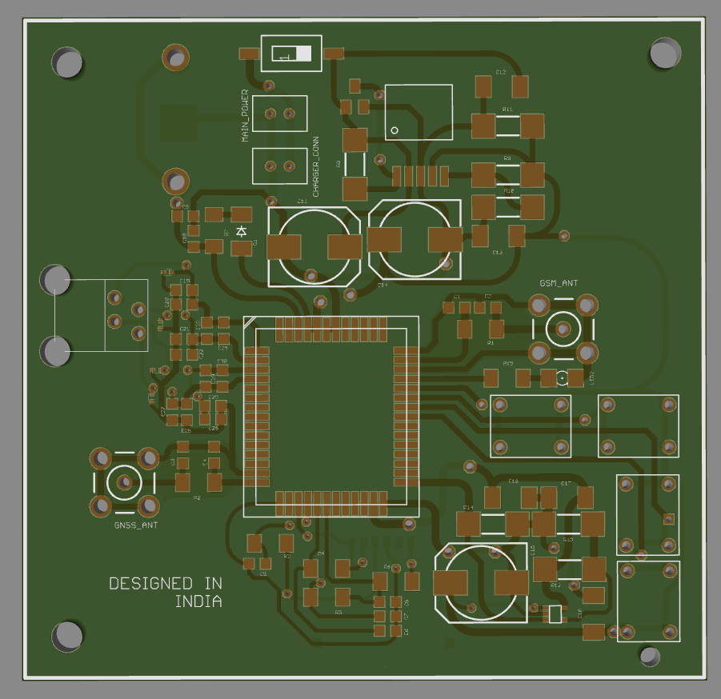
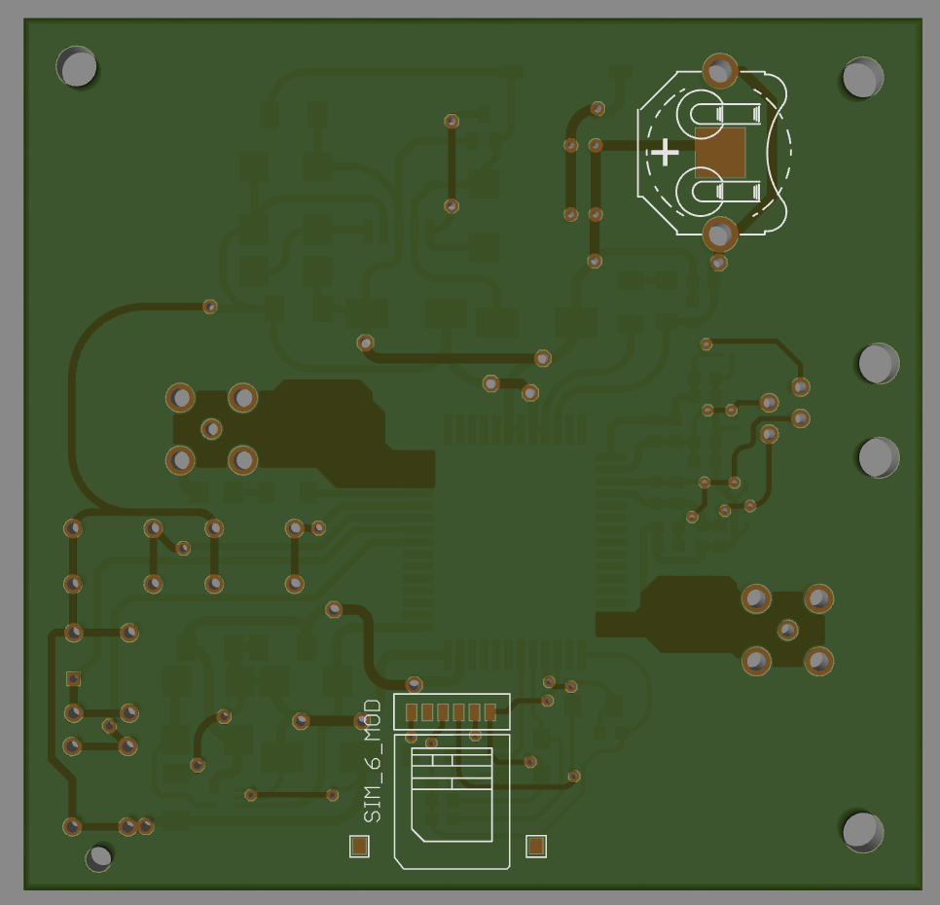
3D VIEW
TOP VIEW
BOTTOM VIEW

Slide 9
Software
Programming language
In order to program the MC60 module, we use embedded C programming language, also this MC60 module
supports only embedded C programming language. The execution of codes/functions are very faster when
compared to other popular programming languages.
If we want to use MC60 module in our application, we need to write a main program in embedded C
language.
When we buy an MC60 module, quectel gives SDK file for that respective module. In that SDK file
they already written some default programs like firmware and necessary header files for the module,
such that we work only on its application layer of the module.
By keeping this SDK file and we would write a main program on that file for MC60 module for
our application.

Slide 10
Real time use
We program the MC60 module for this application in the concept of comparing the values.
The corresponding latitude and longitude details of the path was taken initially and set reference to the module.
The module able to get its exact location and compare the values (latitude and longitude) with the reference locations and it sends an alert message of deviation to the law enforcement agency when a single reference value is not matched.
In this device we add a call function which helps the driver to communicate with the law enforcement agency in case of any emergency situation by just pressing a simple button to make and cut a call also pick up call from enforcement agency by just pressing a button.

Slide 11
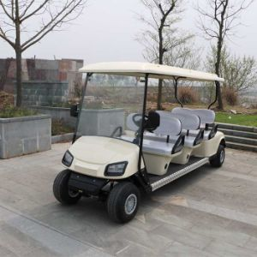
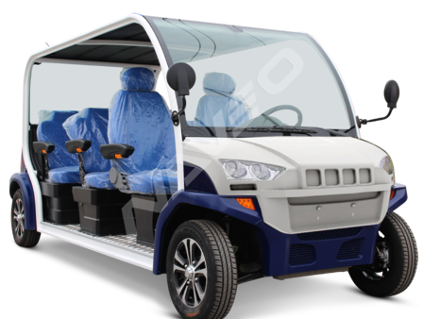
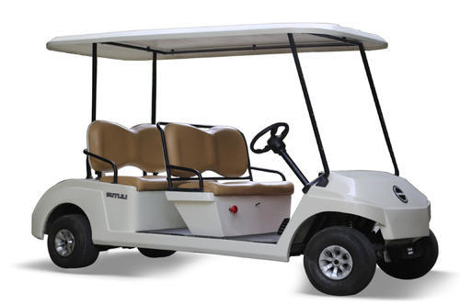
Due to small in size and less power consumption we fix this device in the battery operated vehicles
such that these battery vehicles are used in parks, etc. hence we satisfies the main condition that
used in Kaziranga National Park, Assam.
Battery vehicles

Slide 12

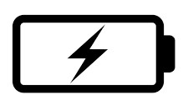

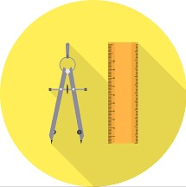
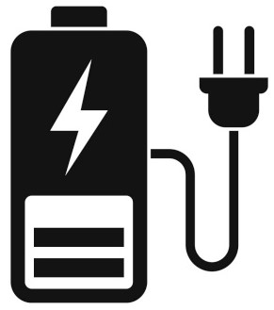
Pros and Cons
Overall cost of the product is
around ₹ 1800/- i.e. cost efficient
For device operation it requires
typically 4.00V / 1.7Amps
i.e. power efficient
Less maintenance
If you fix this device in the
vehicle, we may charge the
battery of the device
through the vehicle’s
battery.
Size of the product is 7Cm X 7Cm
i.e. ultra compact in size

Slide 13
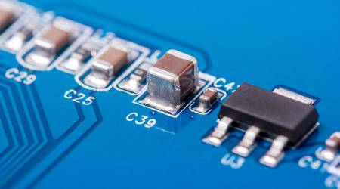
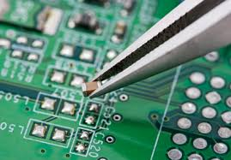
Cost of the product
Protection case
200/-
Total cost of the product is
1800/-
Other required components
including smd resistors,
capacitors, battery, etc..
600/-
MC60 module
500/-
PCB fabrication
(double layer)
500/-

Slide 14

Calling function
CALL FROM AGENCY
In case of any emergency the law enforcement agency want to communicate with the driver , by just dialing the number already fixed in the vehicle’s module and the indication will be made then the driver just simply press a button to communicate by using handset .
CALL FROM DRIVER
If the driver wants to communicate with the agency, then the driver just pressing a button to call. The agencies communication number was already set in the main program of the module.

Slide 15

Conclusion
Due to small in size, power efficient, less maintenance, more reliable, low cost,
we could fix the device in the battery operated vehicles. Hence we use this vehicles
in the Kaziranga national park, Assam for tourism and other relevant works.
Demo video link: https://drive.google.com/file/d/1BhuPp5V5nZRGszjZBplytI4NZEd-tO9x/view?usp=sharing
THANK YOU
TEAM VAJRA
SOUNDAR S

